Slide 1
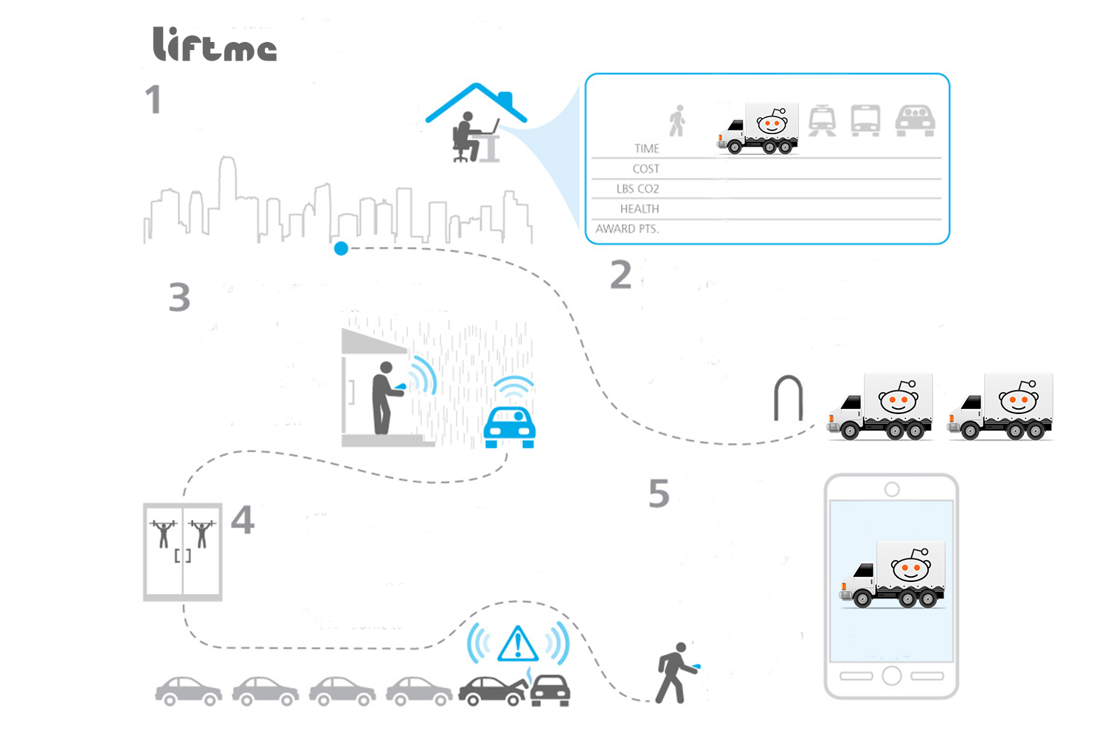
USER SCENARIO 1
From home in the morning ,you need to get across town for afternoon meeting with a client.
A quick compares of time, cost carbon foot print associated with all your personal travel options, you see that there are other apps user within a couple blocks of your office client & opt to
grab a car
share across town.
It’s raining when you are meeting wraps up, so you opts to share a ride to the gym after work.
You pull up your
Liftme app and see
that a driver headed
In the same direction is
just a few blocks away.
When you get out from the locker you have an alert there is accident a half mile from your apartment & traffic at stand still. You opt to burn
Off some more additional
Calories & walk home rather wait for the traffic.
When you get home you log the day trip to see the summary page & how you have help to reduce traffic and emission

Slide 2
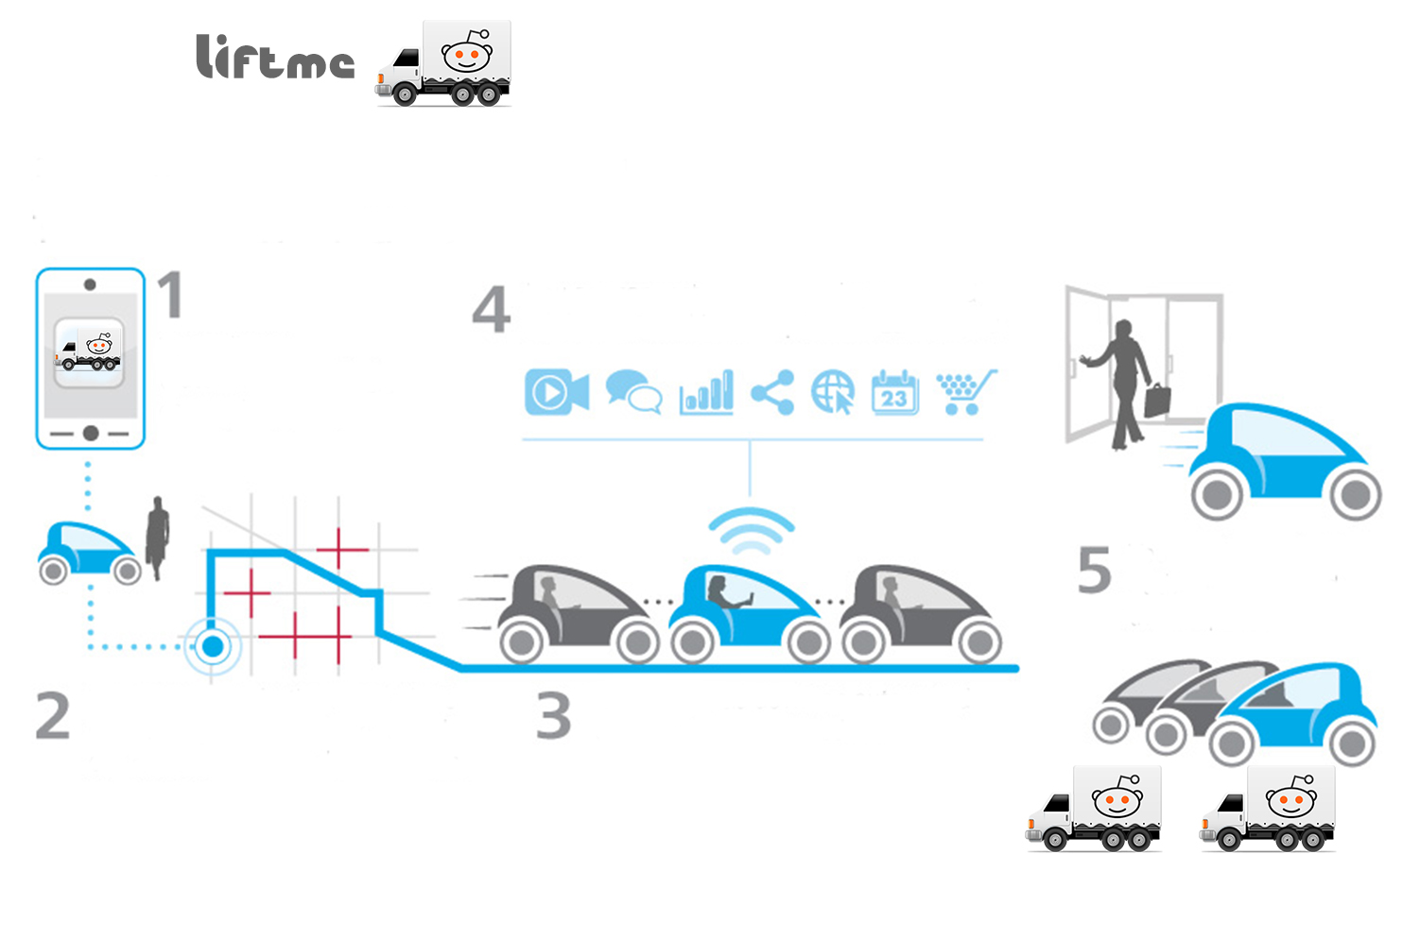
USER SCENARIO 2
You are drop off at the door step of your home and the car drive off with a smile☺
Bob’s open the (liftme )apps,
log in and look for other user, using same app.
You are connected to everything you need while you travelling in the car smile☺
You enter your destination ,date time, and dynamically send’s your information to the cloud system.
Your car travel road way with other user, who don’t have the app yet

Slide 3
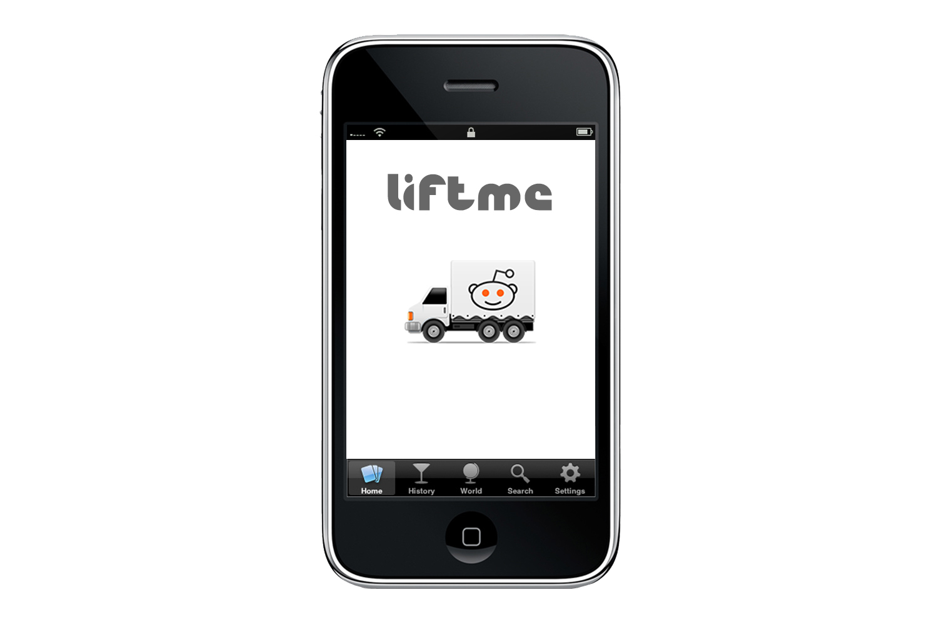
Logo

